Slide 1


Applications of Decision Theory to Apple Orchards
Stephen Brownsey

Slide 2
Presentation Overview:
1
Brief introduction to the project and research idea
2
Problems encountered and specification progress
3
Analysis, methods
4
Demonstration of the shiny application built
5
Results , future improvements and recommendations
6
Questions

Slide 3
Introduction – Why Bees?
1
Global shortage of pollination services
2
Bee populations being hit hard
3
Future sustainability and can we help?

Slide 4
Introduction – Original Research
1
Original research (Park et al. 2015), looked in detail at the benefits of surrounding natural landscape
2
Honey bee abundance was driven solely by temperature
3
Wild bee abundance was affected by previous year’s pesticide levels

Slide 5
Introduction – New Research
1
Analyse the data collected from both decision theory and non-decision theory perspectives
2
Observe how the different approaches can model the data collected and decide upon future methods
3
Can clustering demonstrate the harmful effect of increased pesticide protocols on wild bee populations?

Slide 6
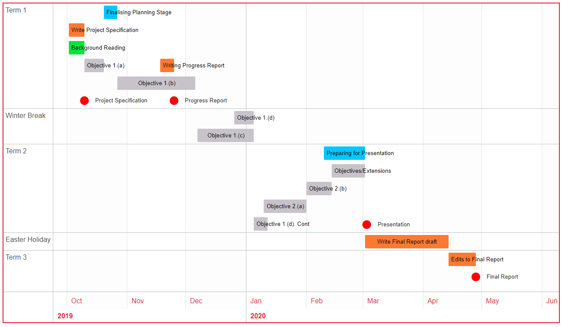
Project Management

Slide 7
Specification Changes
1
Alternative decision rules changed to alternative clustering methods
2
Quantifying the different perspectives changed to Quantifying the different clustering methods
3
General shift towards a Clustering/Machine learning approach and justification

Slide 8
Problems Encountered
1
Exploratory data analysis and analysing the clustering methods took longer than expected
2
Objectives not self-contained, iterative implementation

Slide 9
Problems Encountered (data)
1
No yield data
2
Lack of data points
3
No dates on day data

Slide 10
Analysis – The Methods
1
Perform clustering analysis on the orchard protocols
2
Adjust bee observed values for confounding variables
3
Observe trends, similarities and differences amongst the various protocols considered

Slide 11
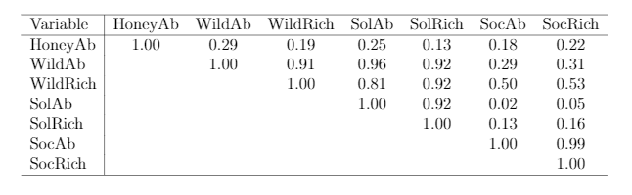
Analysis – Selecting Variables
1
Correlation of > 0.9 required

Slide 12
Analysis – Selecting Variables
1
Correlation of > 0.9 required

Slide 13
Analysis – Selecting Variables
1
Correlation of > 0.9 required

Slide 14
Analysis – Clustering
1
4 (x2) Different methods considered
2
Decision theory clustering approach:
CV K-means, Agglomerative Hierarchical Clustering (AHC)
3
Classical clustering approach:
AHC (Euclidean/Maximum)

Slide 15
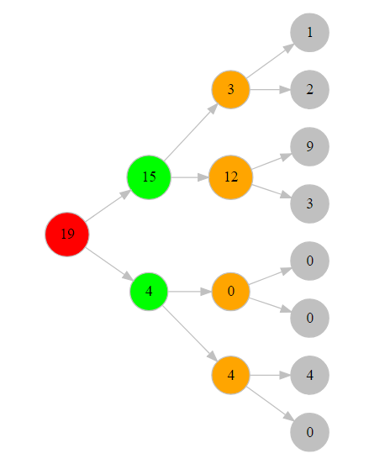
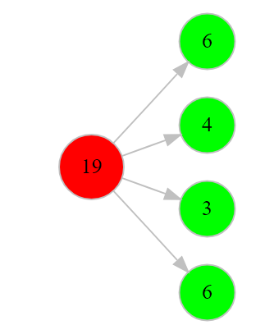
Analysis – Clustering

Slide 16
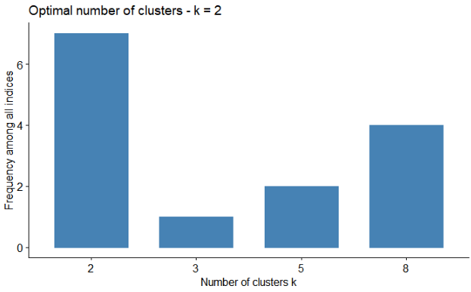
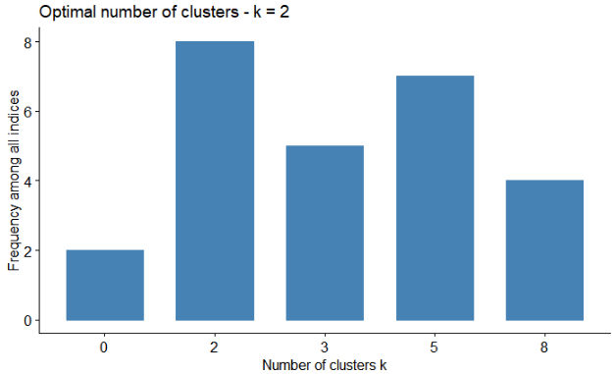
Analysis – Clustering
Standardised Maximum Linkage Function
Standardised Euclidean Linkage Function

Slide 17
Analysis – Clustering
Standardised Maximum Linkage Function
Standardised Euclidean Linkage Function

Slide 18
Analysis – Clustering
Standardised Maximum Linkage Function
Standardised Euclidean Linkage Function

Slide 19
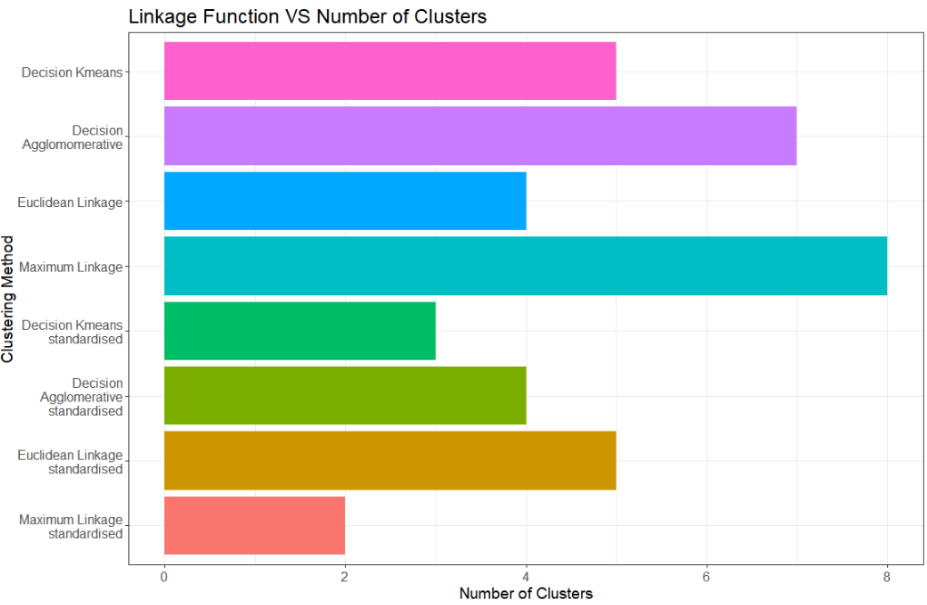
Analysis – Clustering

Slide 20
Analysis – Statistical Tests
1
Statistically significant positive trends with temperature and bee count
2
Statistically significant positive trends with percentage of natural surroundings and bee count
3
No statistically significant trends with day, region, bloom and local diversity when compared with bee count

Slide 21
Analysis – Effects of Confounders
Cluster | Wild Abundance | Adjusted Wild Abundance | Social Richness | Adjusted Social Richness
6 | 1.175 | 1.588 | 0.202 | 0.295
7 | 1.732 | 1.174 | 1.007 | 0.449
adjusted_bee value = bee_value + ((20 - temp) * temp_factor) + ((mean_x2000 - X2000nat) * X2000_factor)

Slide 22
RShiny Application Demo
https://brownsey.shinyapps.io/shinyapp/

Slide 23
Analysis - Results
1
As pesticide level increases, the expected abundance and richness of wild pollinators decreases
2
Confirmed natural surroundings benefit bees and harsher pesticide protocols are damaging the bee colonies
3
Raw (non-standardised) pesticide results formed better than standardised ones
4
Insufficient data to conclude optimum method

Slide 24
Analysis – Future Work
1
Acquire more data, yield and day data
2
Apply the ecologist vs economist trade off
3
Increase size of decision tree
4
Publishing an all-encompassing application

Slide 25
Thank you!
References:
Shiny Application: https://brownsey.shinyapps.io/shinyapp/
Shiny Gantt Chart: https://brownsey.shinyapps.io/brownsey_gantt/
GitHub: https://github.com/Brownsey/wild_pollinators
Email: S.Brownsey@warwick.ac.uk
Original Research: https://royalsocietypublishing.org/doi/pdf/10.1098/rspb.2015.0299

Slide 26
Additional Slides

Slide 27
Analysis – Region
1
3 Categories: LO = Lake Ontario; GV = Geneva; S = Southern Cayuga Lake
2
Levene’s Test for Homogeneity of Variance: P = 0.8234
3
Shapiro Test for normally distributed residuals: P = 0.3546
4
ANOVA Test for one of the regions coming from a different population:
H0: Regions all come from the same population
H1: Atleast one of the Regions comes from a different population
P = 0.542

Slide 28
Analysis – Day
1
2 categories: day 1 and day 2
2
F-Test for homogeneity of variance: P = 0.8908
3
Two-sided paired Students T-Test:
H0: Mean(day 1) = Mean(day 2)
H1: Mean(day 1) != Mean(day 2)
P = 0.0588
4
Aggregated day 1 and day 2 bee values to get a per orchard/pesticide protocol bee value for both Wild Abundance and Social Richness

Slide 29
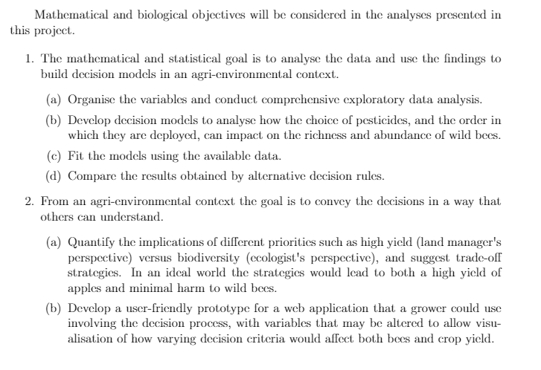
Specification

Slide 30
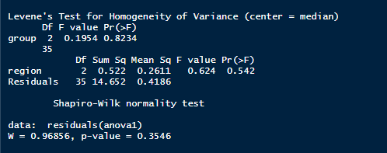
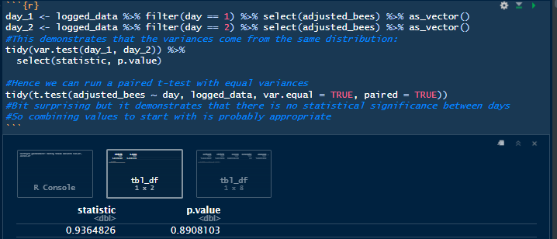

Region R output
Day R output

Slide 31
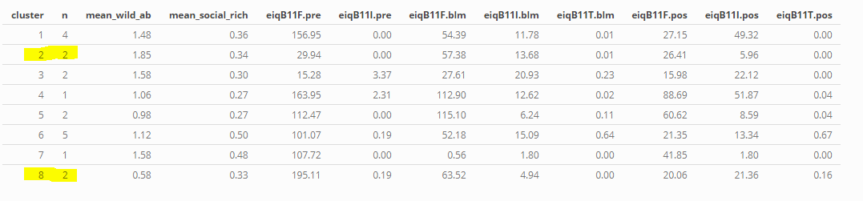
Higher Pesticide -> Lower Bee values

